Slide 1
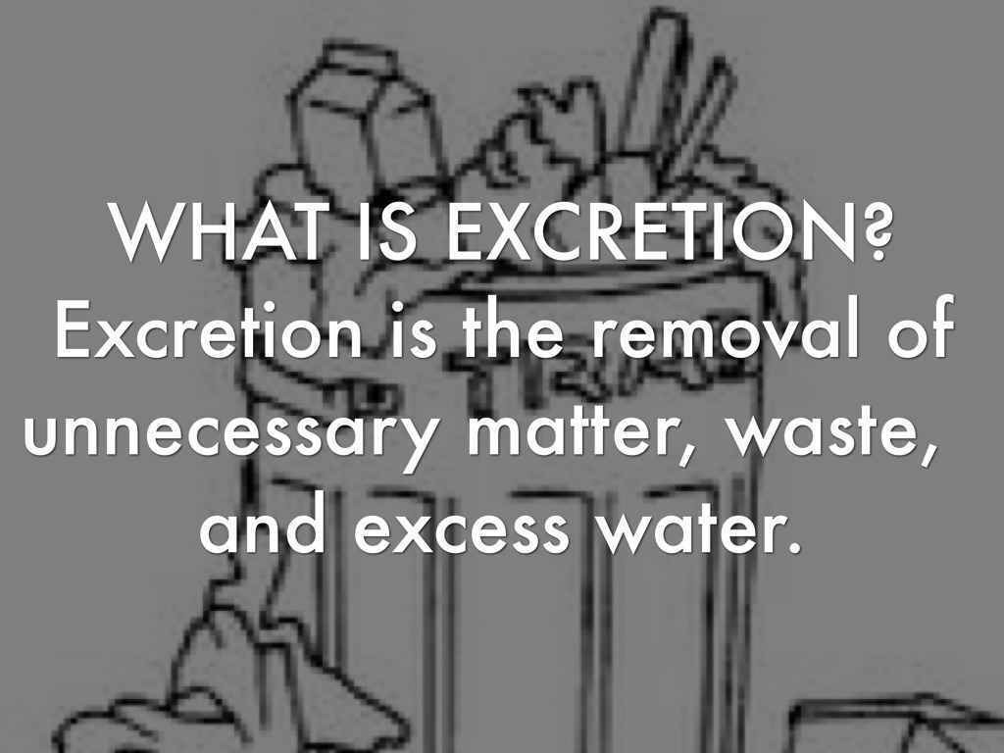
Mehak rafiq
Excretion in vertebrate

Slide 2
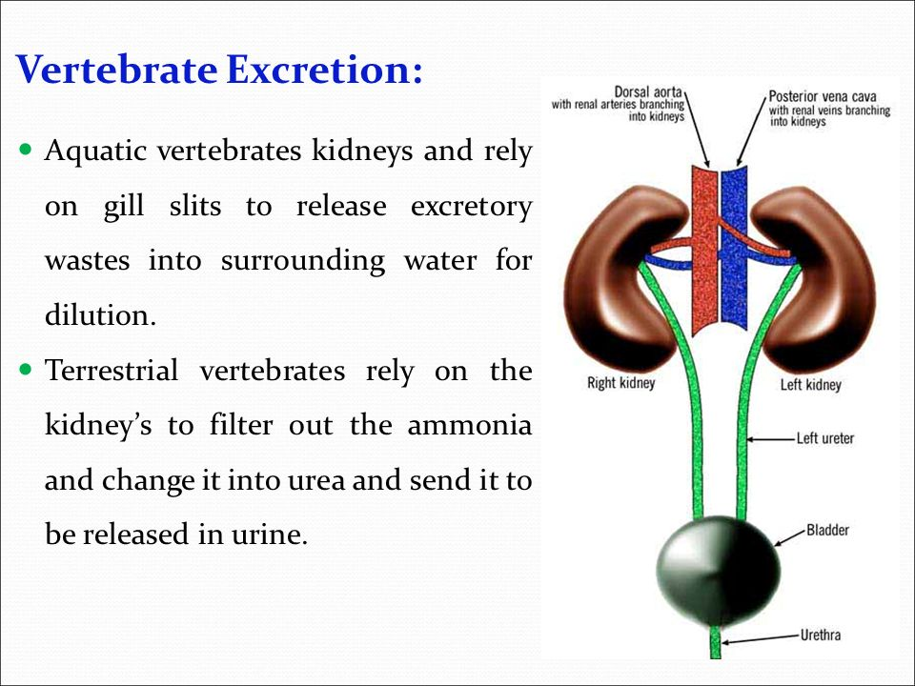
Excretion:

Slide 3
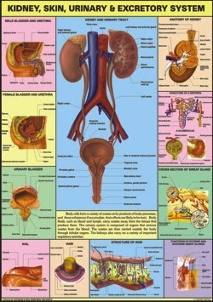
Excretion in Man

Slide 4
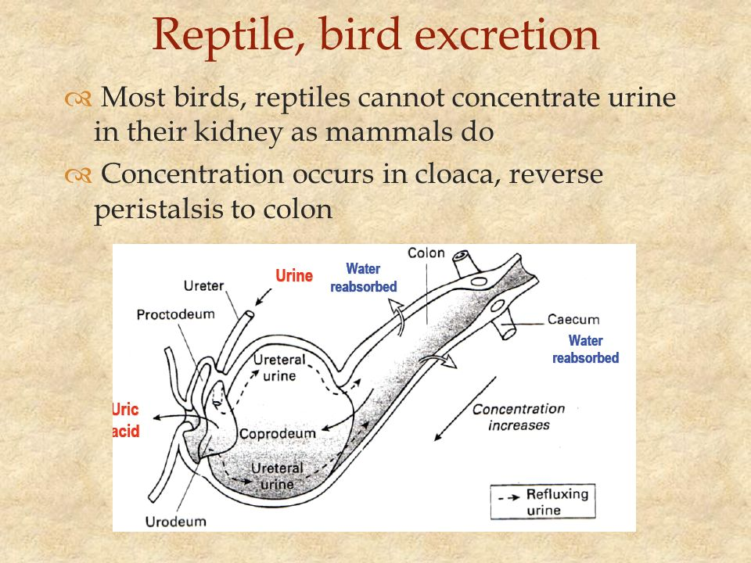
Excretion In Birds & Reptiles:

